Slide 1

Forecast Verification
Atmospheric Simulations
Nadia Kairaktidi
1068622

Slide 2
Forecast Verification through Comparative Analysis of Observed and Modelled Temperature Data - TAVG
In this study, we evaluate the performance of a temperature forecasting model by conducting a verification analysis against observed data. Specifically, we compare two datasets: one comprising actual, observed temperature measurements, and the other consisting of corresponding model-generated values. For both datasets, we derive the daily average temperature (TAVG) from the original hourly records. These daily averages are then used to construct time series plots for both observed and modelled temperatures, which are overlaid to facilitate visual comparison. This process is repeated for each month of the year to identify periods where the model exhibits stronger or weaker agreement with the observed data.

Slide 3
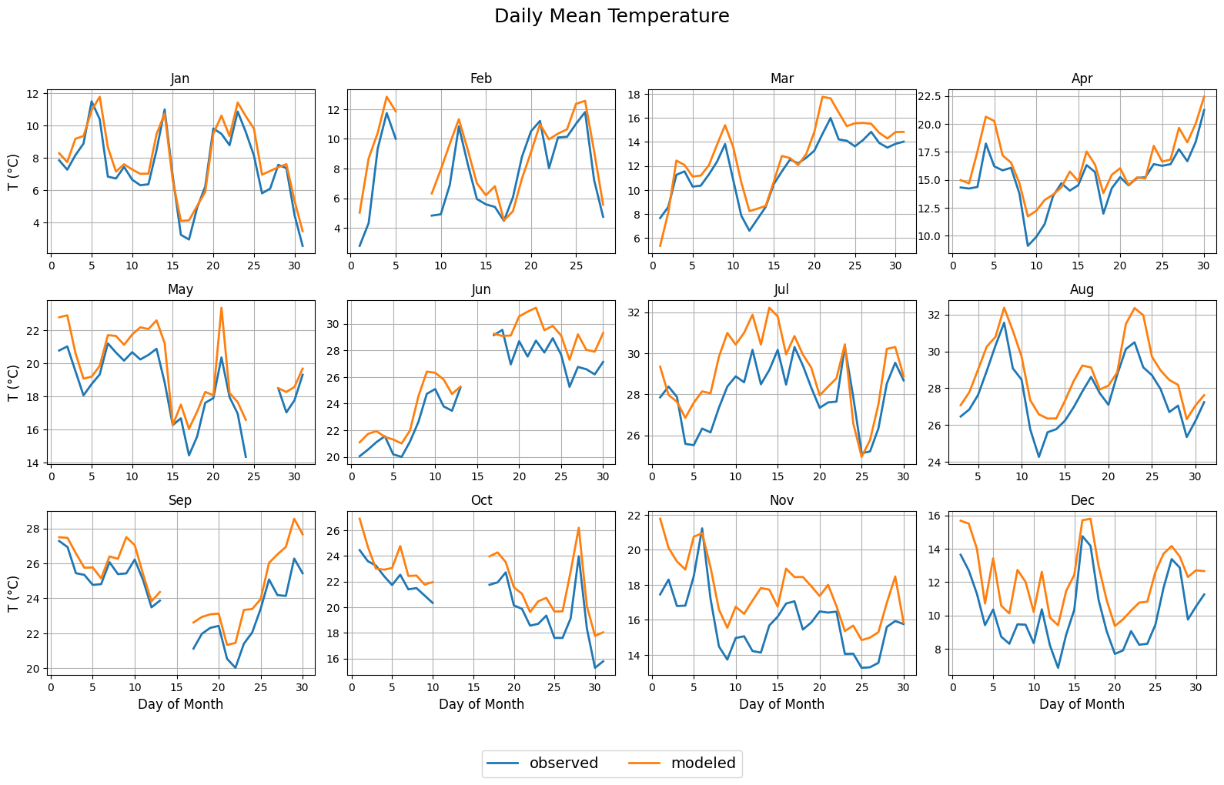

Slide 4
Interpretation and Implications for the Model and Forecast Verification
Model Accuracy in Early Months:
The model demonstrates its highest accuracy in the early months of the year, particularly in January and February, where the observed and modelled temperature lines closely align or even overlap, indicating strong agreement.
Overestimation in Summer:
During the summer months, especially June and July, the model tends to overestimate daily average temperatures, resulting in a consistent positive bias compared to the observed values.
Similar Patterns in Late Year:
A comparable overestimation trend is also evident in the late months of the year, such as November and December, suggesting a seasonal component to the model's bias.
Missing Data:
Five months contain NaN (missing) values, which appear as gaps in the time series plots. These missing values are not confined to a single dataset and may originate from either the observed or the modelled temperature records.

Slide 5
Seasonal Model Performance:
The model's strong performance in January and February suggests that it is better calibrated for cooler, more stable atmospheric conditions, possibly due to reduced variability and fewer extreme events.
Systematic Bias in Warmer Months:
The consistent overestimation of temperatures during summer, and again in late autumn points to a seasonal bias in the model. This could stem from inadequate representation of surface-atmosphere interactions during periods of high solar radiation.
Forecast Verification Insights:
These findings highlight the importance of seasonally stratified verification, rather than relying solely on annual or aggregate performance metrics. Evaluating model accuracy across different times of year reveals biases that would be otherwise masked.
Missing Data Considerations:
The presence of NaN values in both datasets emphasizes the need for robust data handling protocols in forecast verification. These gaps could affect the reliability of performance metrics and should be either imputed carefully or excluded consistently.
Practical Implications:
For operational use, these biases suggest that temperature forecasts should be adjusted or interpreted with caution during summer and late-year periods, possibly using post-processing techniques or model ensembles.

Slide 6
Forecast Verification through Comparative Analysis of Observed and Modelled Temperature Data – TMAX, TMIN
Next, we extend the analysis to include daily maximum (TMAX) and daily minimum (TMIN) temperatures for both datasets. This allows us to assess whether the model's performance is consistent across different temperature metrics, and to identify any variations in model accuracy relative to the daily average (TAVG).

Slide 7
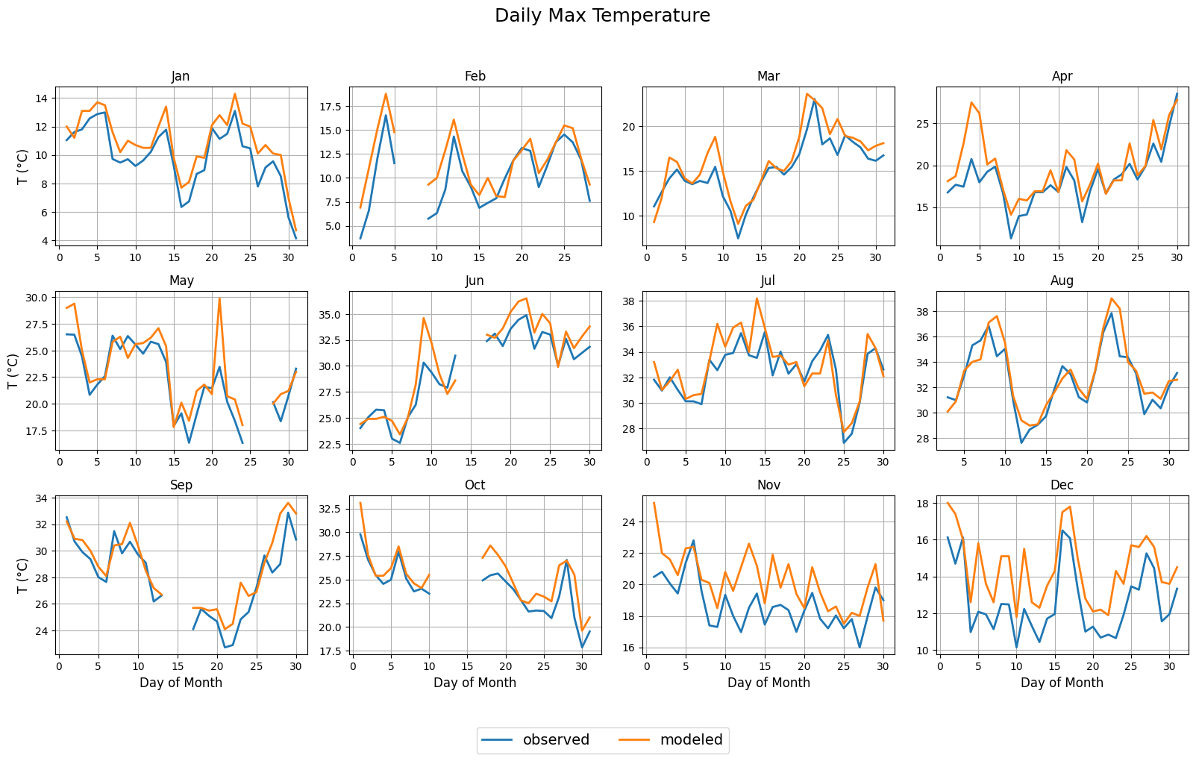

Slide 8
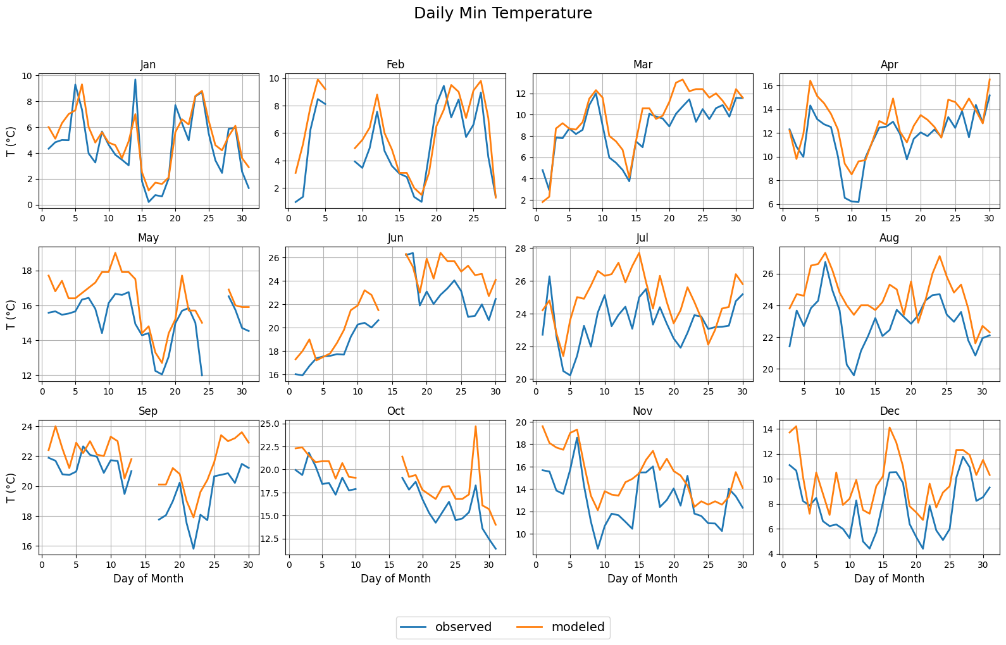

Slide 9
Interpretation and Implications for the Model and Forecast Verification
Model Performance for Maximum Temperature (TMAX):
The model performs consistently well for daily maximum temperatures, showing minimal deviation throughout the year. The smallest discrepancies occur during most months, except for November and December, where the model again tends to overestimate temperatures.
Model Performance for Minimum Temperature (TMIN):
In contrast, the model exhibits larger discrepancies in minimum temperatures, with differences of several degrees between observed and modelled values across most of the year. The best agreement is observed in the early months (January to March). The largest errors occur during the summer months and again in November and December, indicating a recurring seasonal pattern of reduced model accuracy for TMIN.
Missing Data:
As with the average temperature analysis, five months contain NaN values, leading to missing days in the plots. These gaps are present in both datasets and not limited to either the observed or modelled records.

Slide 10
Statistical Metrics
Next, we calculate standard forecast verification metrics, specifically the Mean Error (ME) which, measures the average difference between the modelled and observed values and provides insight into whether the model systematically overestimates or underestimates temperatures and the Mean Squared Error (MSE) which quantifies the average of the squared differences between modelled and observed values, emphasizing larger errors more than ME and serves as an indicator of the overall accuracy of the model.
These metrics were first calculated for the entire dataset, and then separately for each temperature category [mean (TAVG), maximum (TMAX), and minimum (TMIN)] to allow for a more detailed assessment of the model’s performance across different aspects of temperature forecasting. The results are summarized in the following table.
Error | Value
Annual ME | 1.27 °C
Annual MSE | 3.81 °C²
Annual Mean ME | 1.27 °C
Annual Mean MSE | 2.52 °C²
Annual Max ME | 1.17 °C
Annual Max MSE | 3.28 °C²
Annual Min ME | 1.49 °C
Annual Min MSE | 3.83 °C²

Slide 11
Statistical Metrics
General Bias:
The model consistently overestimates temperature, with an average bias of +1.27 °C.
Best Performance:
Achieved for the mean daily temperature (TAVG) – lowest MSE (2.52 °C²) and stable bias. Model also performs well for maximum temperatures (TMAX).
Worst Performance:
Observed in minimum temperatures (TMIN) – highest bias (+1.49 °C) and MSE (3.83 °C²). Suggests the model struggles more with nighttime or early morning conditions.
Overall Accuracy:
Errors are moderate, but non-negligible, especially for TMIN. Seasonal patterns (e.g. summer, late year) contribute to higher deviations.
Error | Value
Annual ME | 1.27 °C
Annual MSE | 3.81 °C²
Annual Mean ME | 1.27 °C
Annual Mean MSE | 2.52 °C²
Annual Max ME | 1.17 °C
Annual Max MSE | 3.28 °C²
Annual Min ME | 1.49 °C
Annual Min MSE | 3.83 °C²

Slide 12
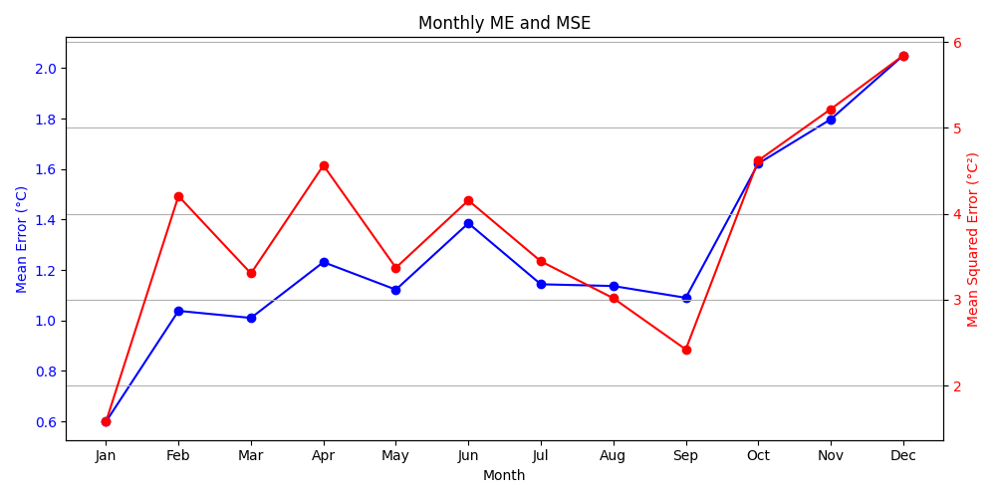
1. General Trend
Both ME and MSE show some fluctuations throughout the year. A significant increase in both ME and MSE is observed starting in October, peaking in December.
2. Mean Error (ME)
Lowest in January (0.6°C).Relatively stable between March and September (hovering around 1.0–1.4°C).Sharp increase from September to December, peaking at 2.05°C.
3. Mean Squared Error (MSE)
Lowest in January (2.0°C²).Fluctuates more sharply than ME (e.g., peaks in February, June, and December).Rises steeply from September onwards, reaching a high of 5.9°C² in December.

Slide 13
Interpretation
The rise in both ME and MSE in the final quarter suggests model performance deteriorates significantly towards the end of the year.
MSE's greater sensitivity shows that larger individual errors are likely occurring in months like June and December.
The relatively stable ME and MSE from March to August indicates better model reliability during these months.
Potential Recommendations
Investigation of seasonal factors or data quality issues in Q4 that may contribute to increased errors.
Consideration of model retraining or recalibration specifically for the colder months (October–December).
Performing error analysis for months with high MSE to identify outliers or patterns.

Slide 14
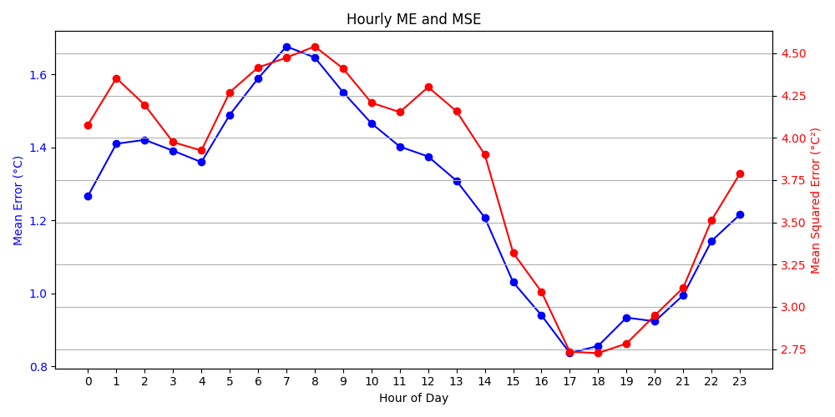
1. General Trend
Both ME and MSE show a distinct diurnal pattern with noticeable peaks and lows.
Errors are highest during early morning and lowest in the late afternoon.
2. Mean Error (ME)
Starts low at 1.28°C at midnight and increases steadily to a peak of 1.67°C at 8 AM.
Gradually declines through the day, reaching a minimum of 0.88°C at 17:00.
Rises again after 18:00, reaching 1.55°C by 23:00.
3. Mean Squared Error (MSE)
Starts at 3.95°C² at midnight and peaks sharply at 4.46°C² around 8 AM.
Falls gradually, reaching the lowest point (2.73°C²) at 17:00 and increases again in the evening, ending at 3.78°C² by 23:00.

Slide 15
Interpretation
The model performs worst in the early morning (6–9 AM) when both ME and MSE are highest. This may reflect challenges in capturing rapid temperature changes around sunrise.
Best performance occurs in the late afternoon (4–6 PM) when both ME and MSE reach their lowest values.
The U-shaped curve suggests a strong daily pattern in model accuracy, potentially tied to solar heating dynamics or daily temperature cycles.
Potential Recommendations
Investigation of why early morning predictions are poor. Possible causes include model lag, insufficient temporal features, or limitations in input data at night.
Consideration of hour-specific model tuning or correction factors, especially for hours with persistently high errors (e.g., 6–9 AM and 21–23 PM).Evaluation of sensor behaviour, input accuracy, or environmental changes that might impact prediction quality at different times.

Slide 16
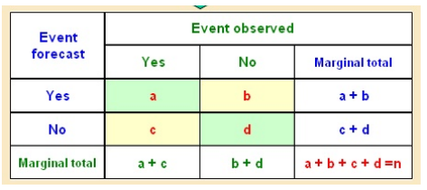
Extreme Events Analysis and Model Evaluation
As a final step, we compute the 95th percentile of the observed temperature measurements in order to define the threshold for identifying "warm days." Using this threshold, we construct a contingency table comparing the observed and modelled data, allowing us to evaluate the model's performance in capturing extreme events. From the contingency table, we calculate key verification metrics: the Probability of Detection (POD), which reflects how well the model identifies actual warm days; the False Alarm Ratio (FAR), indicating the proportion of predicted warm days that did not occur; and the Critical Success Index (CSI), providing an overall measure of forecast accuracy for these events. We then interpret these metrics to assess the model’s effectiveness. Finally, we visualize the relationship between observed and modelled values with a scatter plot, where the computed threshold is clearly marked to highlight the separation between regular and warm days.

Slide 17
The contingency table summarizes the comparison between model forecasts and actual observations of warm days.
Hits (Forecast Yes, Observed Yes): 383 cases, these are the correctly predicted warm days.
False Alarms (Forecast Yes, Observed No): 196 cases, where the model predicted a warm day, but none occurred.
Misses (Forecast No, Observed Yes): 28 case, warm days that occurred but were not forecasted.
Correct Rejections (Forecast No, Observed No): 7601 cases, non-warm days correctly identified by the model.
The table shows that most cases (7601) are correctly forecasted as non-events, while warm events are also captured with relatively few misses.
The number of false alarms (196) is notable but not excessive, suggesting a cautious bias toward capturing potential warm days.
EVENT FORECAST | EVENT | OBSERVED
 | Yes | No | Marginal Total
Yes | 383 | 196 | 579
No | 28 | 7601 | 7629
Marginal Total | 411 | 7797 | 8208

Slide 18
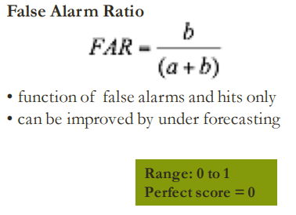
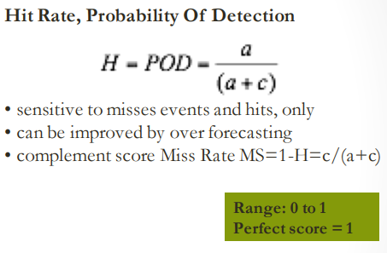
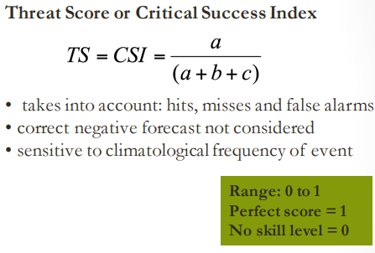

Slide 19
Key Verification Metrics
Based on the contingency table analysis for warm day prediction, the model demonstrates strong performance in detecting actual warm events. The Probability of Detection (POD) is 0.93, indicating that 93% of observed warm days were correctly identified by the model. This reflects a high sensitivity and suggests the model is effective at capturing true positives. However, the False Alarm Ratio (FAR) is 0.34, meaning that 34% of predicted warm days did not actually occur. While this indicates some tendency toward over forecasting, it is not unusually high for extreme event prediction, where prioritizing detection is often preferred. The overall performance is summarized by the Critical Success Index (CSI), which stands at 0.63. This value shows a good balance between hits, false alarms, and misses, and is a strong indicator of model skill, especially considering the typically low frequency of warm events. These metrics collectively suggest that the model performs well, with a trade-off between high detection capability and a moderate level of false alarms.
Metric | Value
POD | 0.93
FAR | 0.34
CSI | 0.63

Slide 20
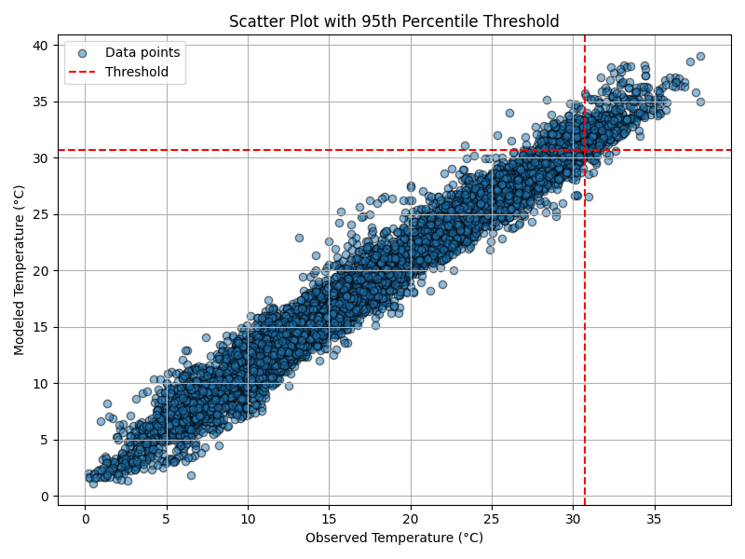
Finally, we present a scatter plot displaying all hourly temperature data, including both observed and modelled values, with the 95th percentile threshold (calculated to be equal to 30.7°C) clearly indicated on the graph.

Slide 21


